Slide 1
BOOTSTRAP
Bharath Vignesh J K
19PW08

Slide 2

What is Bootstrap?
Bootstrap is a free front-end framework (HTML and CSS) for faster and easier web development.
Bootstrap was developed by Mark Otto and Jacob Thornton at Twitter to encourage internal consistency, and was later released as an open source product in August 2011 on GitHub.
Bootstrap is the sixth-most-starred project and was the No. 1 project on GitHub in June 2014.
Bootstrap is famous for being developed with components that have the ability to follow the property of responsive designs

Slide 3
Why use Bootstrap?
Mobile devices Support: In Bootstrap 3, mobile-first styles are part of the core framework
Browser compatibility: Bootstrap is compatible with all modern browsers (Chrome, Firefox, Internet Explorer, Edge, Safari, and Opera)
Responsive Design: It is about using CSS and HTML to resize, hide, shrink, enlarge, or move the content to make it look good on any screen. This allows your page works for computer, tablets and mobile phones.
Latest Version : 4.4

Slide 4
Essentially,
Bootstrap is a collection of predefined CSS classes and, Vanilla JS and JQuery functions.

Slide 5
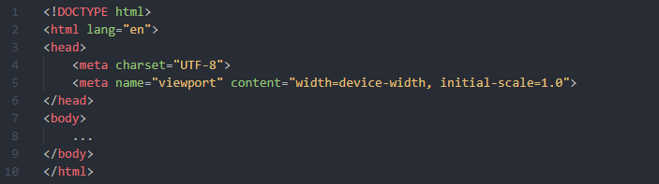
How to use Bootstrap?
Include the HTML5 doctype
Bootstrap is mobile-first so, set the viewport to defaults.
Add proper containers.

Slide 6
How to use Bootstrap?
Now to use the predefined CSS classes and JS functions in Bootstrap, we need to link it to those files. These files can be linked to a Online CDN(Content-Delivery Network) or can also be hosted locally.
Using a Online CDN:

Slide 7
Bootstrap’s Grid system

Slide 8
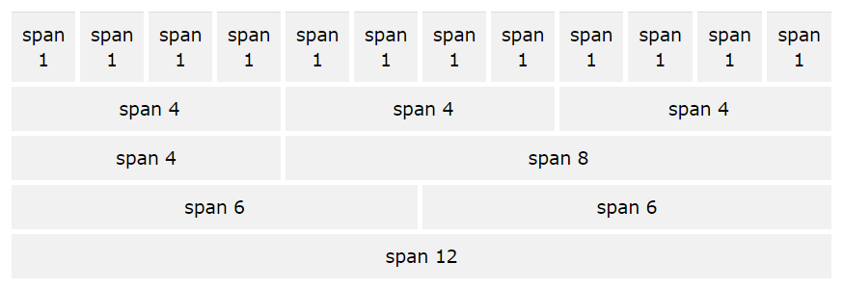
Bootstrap’s Grid system
The layout of a Bootstrap is divided into 12 columns. We can span multiple columns if we need to. This is used to ensure that the responsiveness and are resizable.

Slide 9
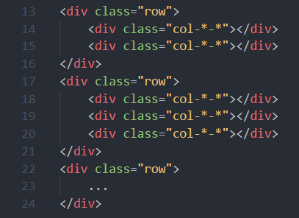
Bootstrap’s Grid system
The Bootstrap grid system has four classes:
xs (for phones)
sm (for tablets
md (for small laptops)
lg (for laptops and desktops)
First we create a row (<div class="row">), then we add the desired number of columns (tags with appropriate .col-*-* classes). The no. of cols spanned must always add up to 12 for a row. All items must be inside a container.

Slide 10
Bootstrap’s Typography
Bootstrap overrides the default attributes of many tags in HTML.
Bootstrap's global default font-size is 14px, with a line-height of 1.428.
All <p> elements have a bottom margin that equals half their computed line-height (10px by default).
To show the quote on the right, we use the .blockquote-reverse class.
The classes for text colors are: .text-muted, .text-primary, .text-success, .text-info, .text-warning, and .text-danger.
The classes for background colors are:.bg-primary, .bg-success, .bg-info, .bg-warning, and .bg-danger.

Slide 11
Bootstrap’s Templates

Slide 12
Bootstrap Tables
7 main classes:
.table
.table-striped
.table-bordered
.table-borderless
.table-hover
.table-dark
.table-sm
9 contextual classes:
.active
.success
.info
.warning
.danger
.primary
.secondary
.light
.dark

Slide 13

Bootstrap Images
Image classes
.img-responsive
.img-thumbnail
.img-rounded
.img-circle

Slide 14
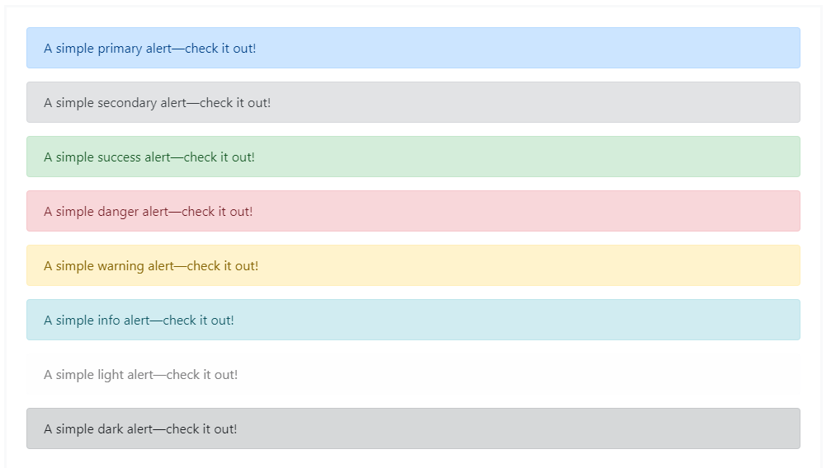
Bootstrap Alerts
9 alert classes:
.active
.success
.info
.warning
.danger
.primary
.secondary
.light
.dark

Slide 15
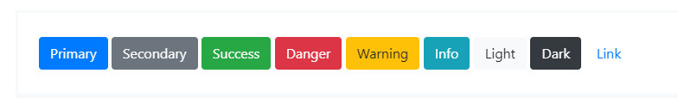
Bootstrap Buttons
9 Button classes:
.btn-link
.btn-primary
.btn-secondary
.btn-success
.btn-info
.btn-warning
.btn-danger
.btn-light
.btn-dark

Slide 16
References
Bootstrap offers many other templates for other requirements such as Navbars, Cards, Spinners, Tooltips and so on.
The documentation can be found at : https://getbootstrap.com/docs/4.4/
References:
https://getbootstrap.com/
https://www.w3schools.com/

Slide 17
Any Questions?

